Slide 1
Final Project Proposal – An Interactive Dashboard for Weather Stations Sepehr (Sep) Sabeti – ITCS 4123/5123 – Visualization and Visual Communications

Slide 2
Overview
Objective
Data
Task
Dashboard
Plan

Slide 3
Objective
The main objective of this project is to create an interactive multi-view dashboard for weather stations
The weather stations for this project will be chosen in the state of Virginia.
The Dashboard would give users the capability of visualizing multiple weather features next to each other
The temporal content of the data is between 2015-2020.

Slide 4
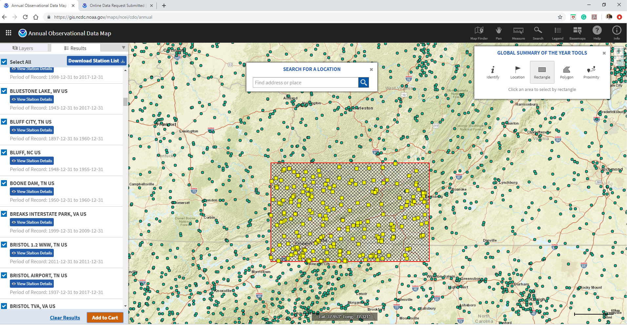
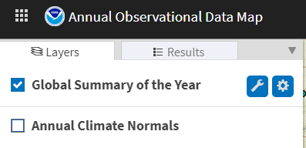
Data
The data will be collected from NOAA
Click
Lat=37.648
Lon=-82.967
Lat=36.319
Lon=-80.324

Slide 5
Task
The main purpose of this dashboard is to put at least two features together to enable us to investigate the correlation between features in a selected time in two different stations.

Slide 6
Dashboard
In the dashboard, at least two scatter plots and one bar chart will be included. However, the objectives are not limited to only these options and depending on the needs, I will add more views.

Slide 7
Plan
First week: Data collection, data preprocessing, and visualization of the locations of the weather stations.
Second week: the first two views of the dashboard
Third week: Finishing up the dashboard and debugging the previous codes if any
Fourth week: Final execution and demo

